Slide 1


Souq Lebanese Grill
Google Ads campaign

Slide 2
Motivation
The business would like to target a specific demographic of the Windsor population.
01
The business would like to increase business with retired senior citizens.
02
the business would like to market their business to this target segment and use marketing analytics to make their campaign a success.
03

Slide 3
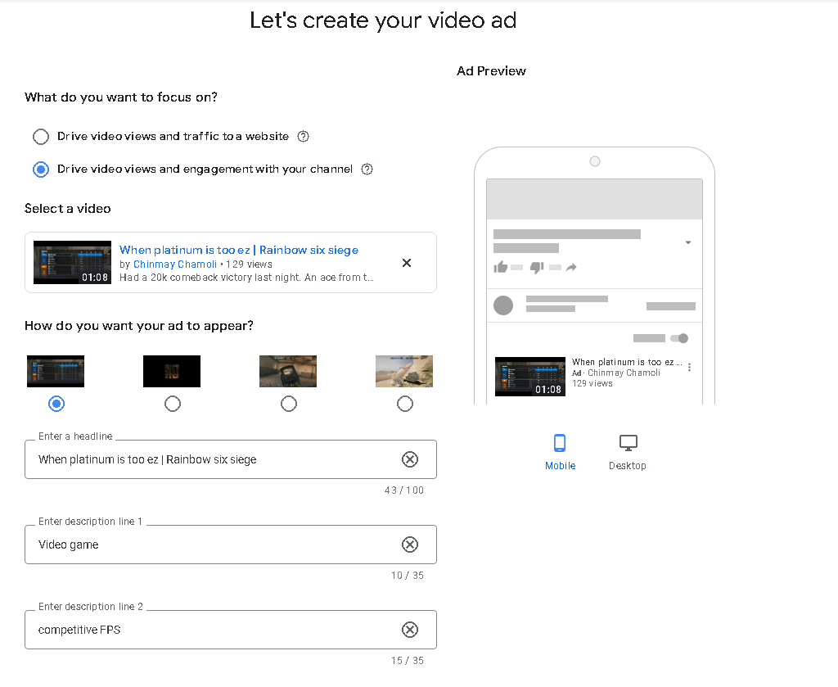
Setting up a google ad
First, we took a video ad from https://www.instagram.com/souqyqg/
We then wrote some headlines and descriptions for the ad.
We can select drive traffic to a website to pull customers to Souq website from the ad.

Slide 4
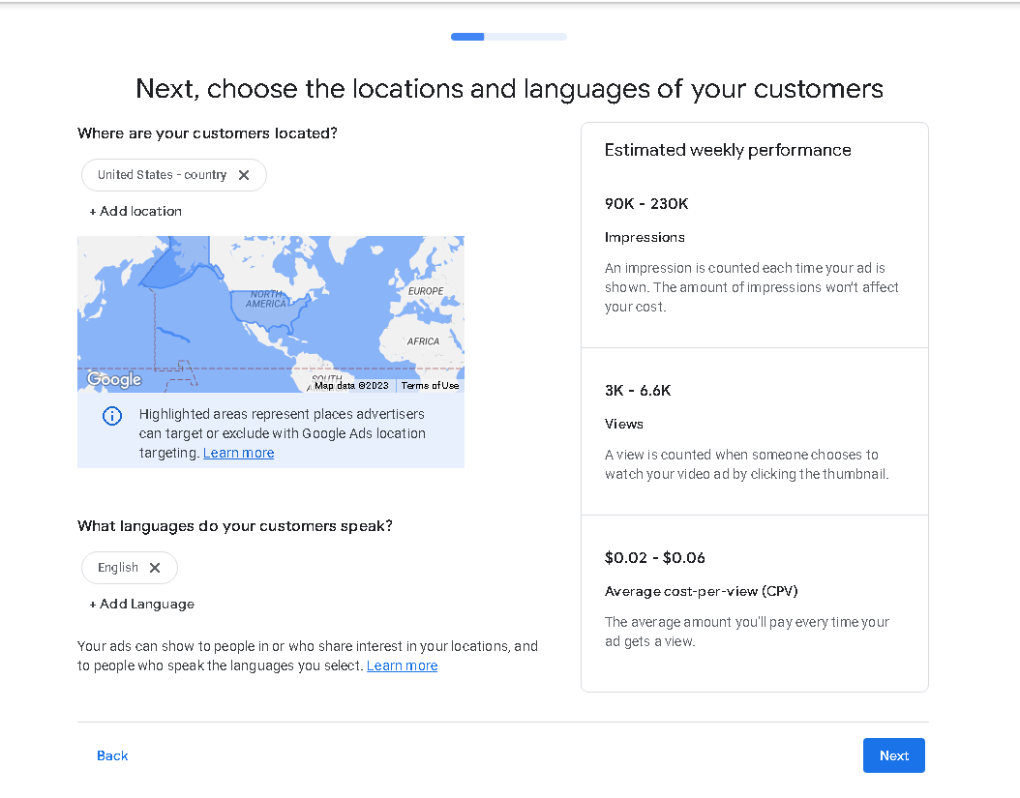
Geographic targeting
The next step was to target the customers by their location. We are interested in the population of Windsor since Souq is a local restaurant.

Slide 5
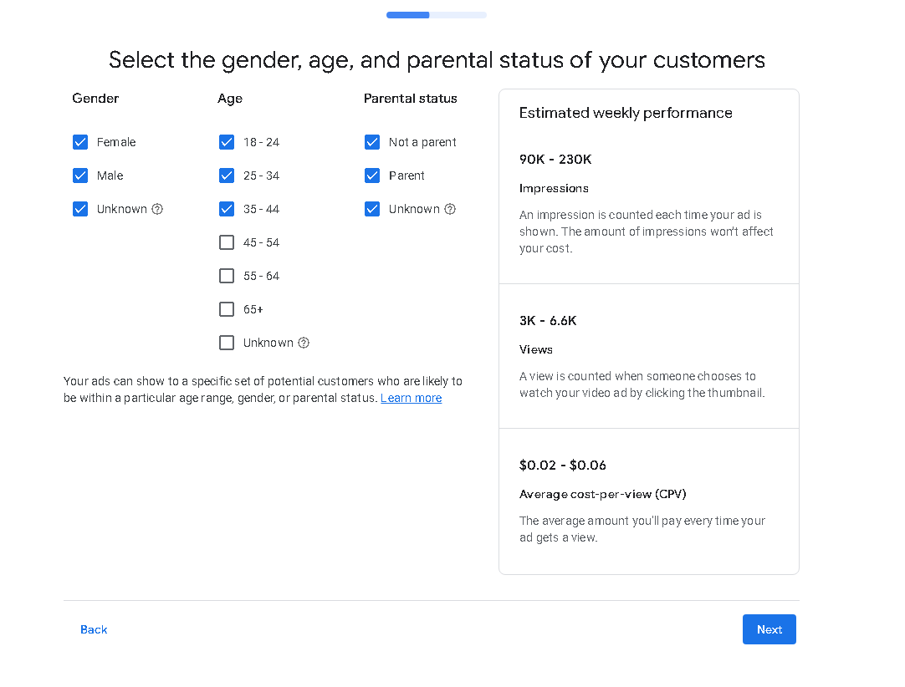
Demographic targeting
The next step is to target the customers by their demographics such as age, gender etc.

Slide 6
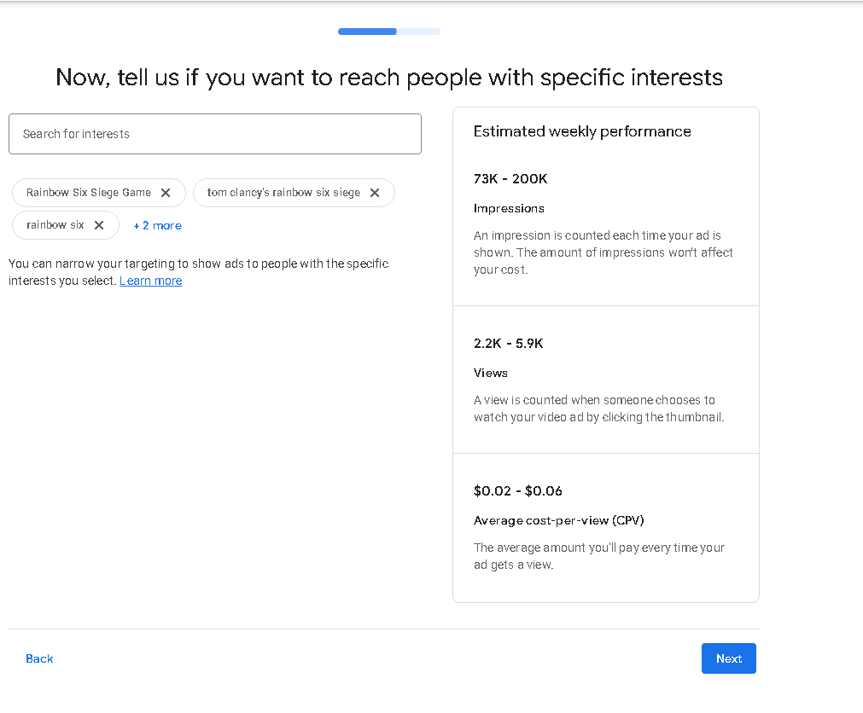
Keywords
The next step which is crucial for google ads was to select the keywords for our ad campaign. This is a crucial step which can make or break the ad campaign.

Slide 7
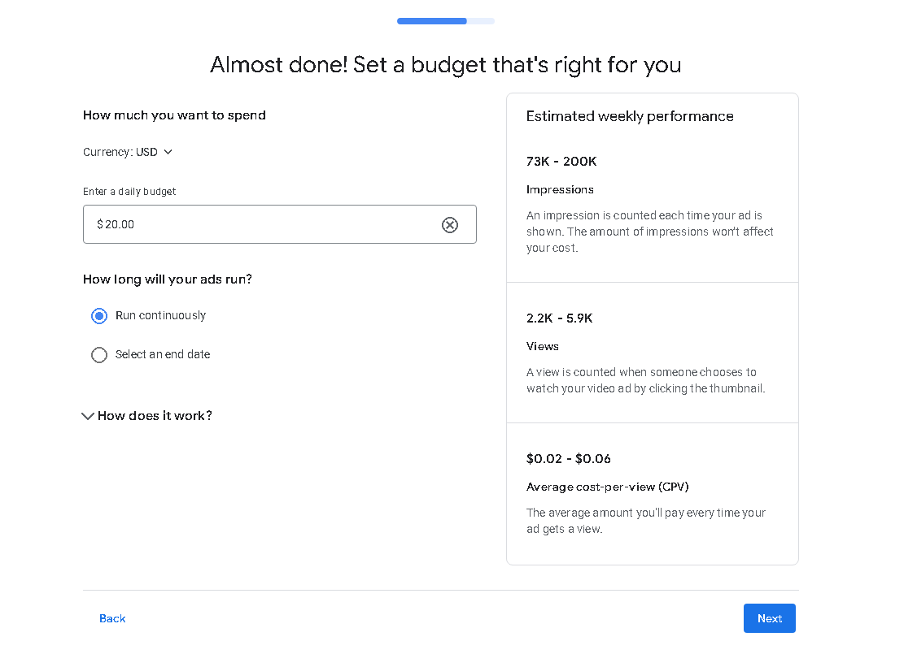
Budget
Finally, we set a daily budget and we could see the estimates for weekly performance for the same. At this stage, we set the option for the end date of our ad campaign to make sure the campaign followed T of the SMART objectives(Time bound).

Slide 8
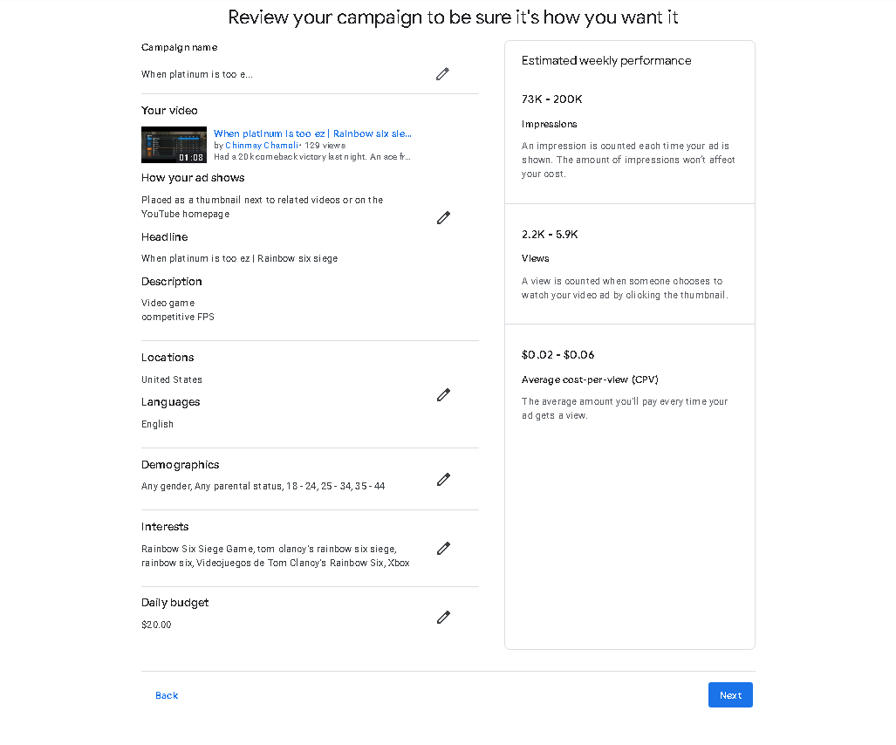
Review the ad
At last, we review the ad. This is the stage where we can make any changes if needed to our ad campaign. After reviewing, we can enter our payment information and push the ad live.

Slide 9
What next?
Review keywords
Review search terms
Review the ad body
Review landing pages
Repeat

Slide 10
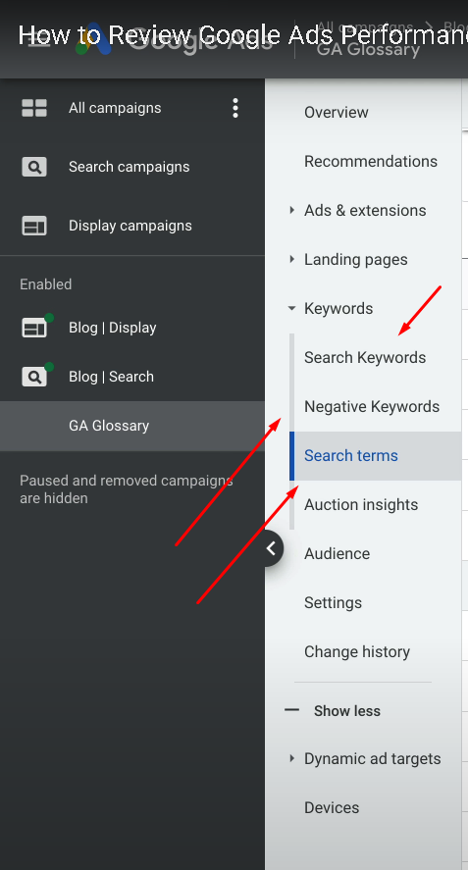
How does it look in google ads?
While the ad campaign is going on, we keep iterating through the process of reviewing keywords, search terms, landing pages and the ad body and making necessary changes to maximize click-through rate as well as conversion rate.

Slide 11
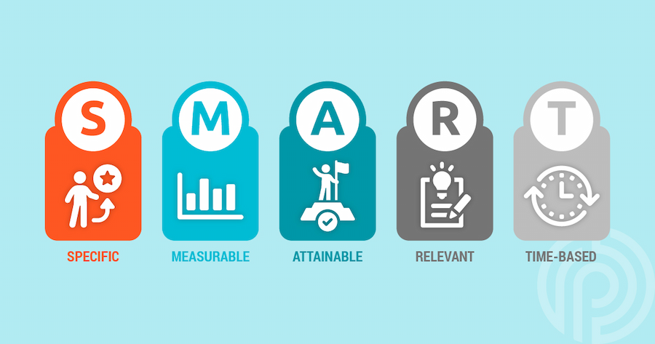
Evaluation
Specific: We chose conversion value as our metric to be specific as to what we wanted from the campaign.
Measurable: Conversion value was measurable in dollars.
Attainable: We set the target to $10000 which was attainable for our campaign.
Relevant: Revenue seemed to be a metric that was relevant to the business audience.
Time based: We set the time frame for this campaign as 1 month, so the project was time bound.

Slide 12
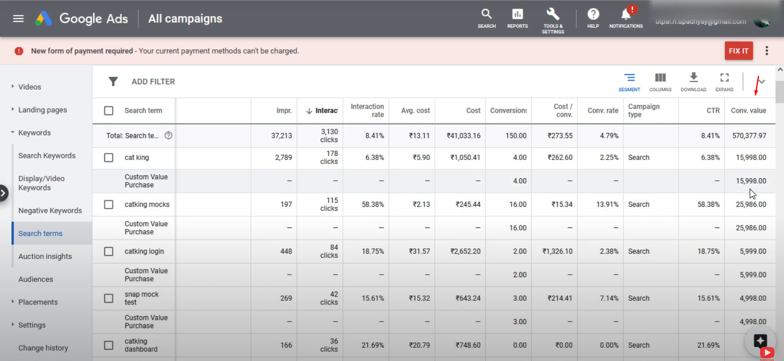
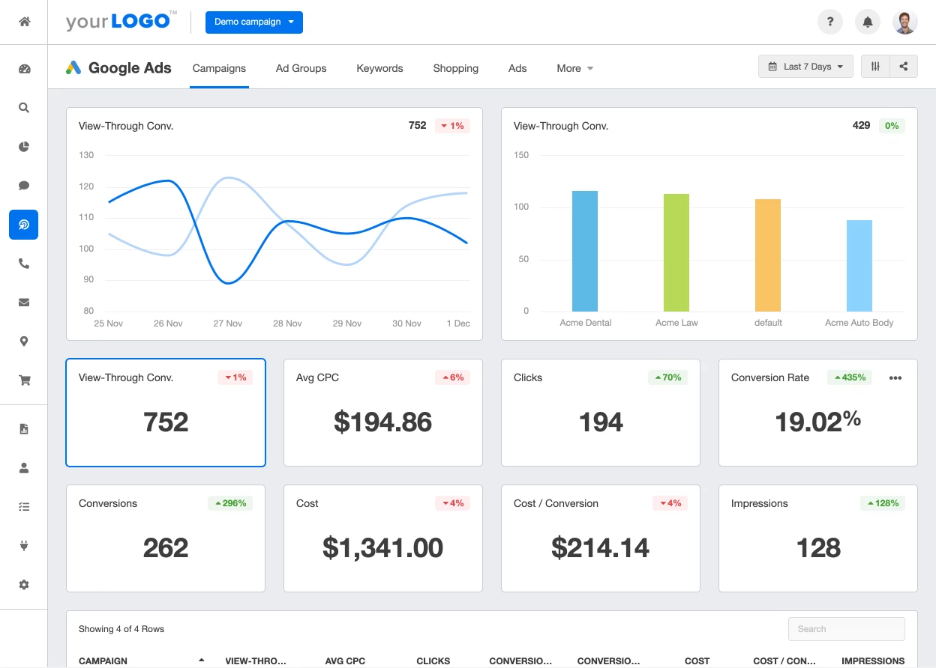
Evaluation(Contd.)

Slide 13
Is that all?
Not really!
After the ad campaign is over, we will have data on the people that engaged with our ads. We will know who converted and who did not.
The next task will be to figure out why the people who are not converting are not converting.
Finally, we can then decide to launch a follow up personalized marketing campaign targeting those who did not convert the first time.

Slide 14
Conclusion
In summary, we launched a marketing campaign for Souq Lebanese grill on google ads where we targeted customers based on their geographical location and demographics.
This ad campaign would also give us information about customers that helps us with behavioural as well as pyschographical targeting of customers in future campaigns.
At the end, we evaluated our project with SMART objectives, documented the lessons learned during the project and closed the project with a final meeting with the business owners.

